Slide 1
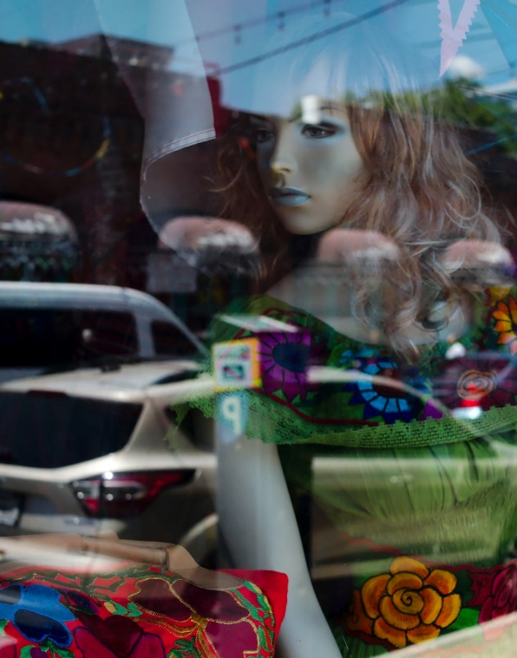
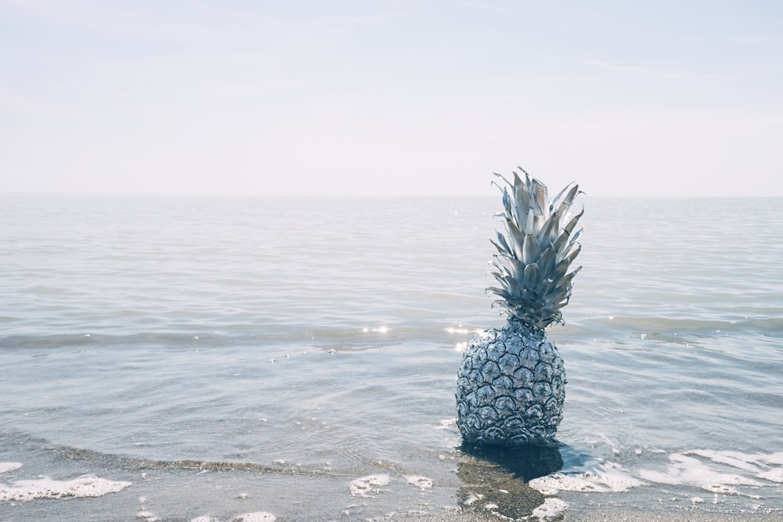
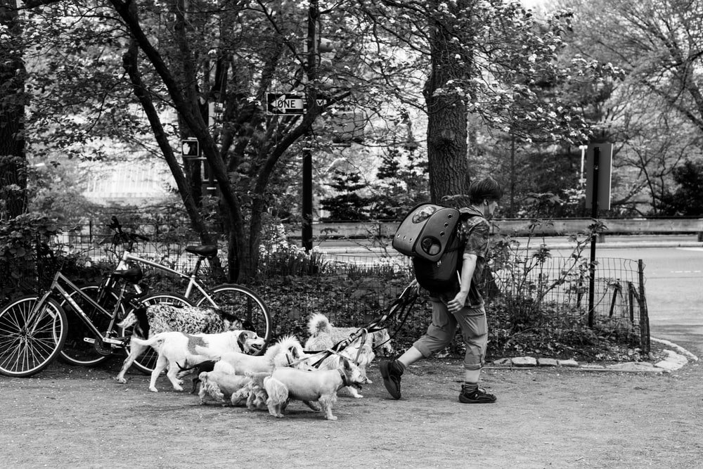
Conversation Class Australia
Christopher bAUMAN

Slide 2
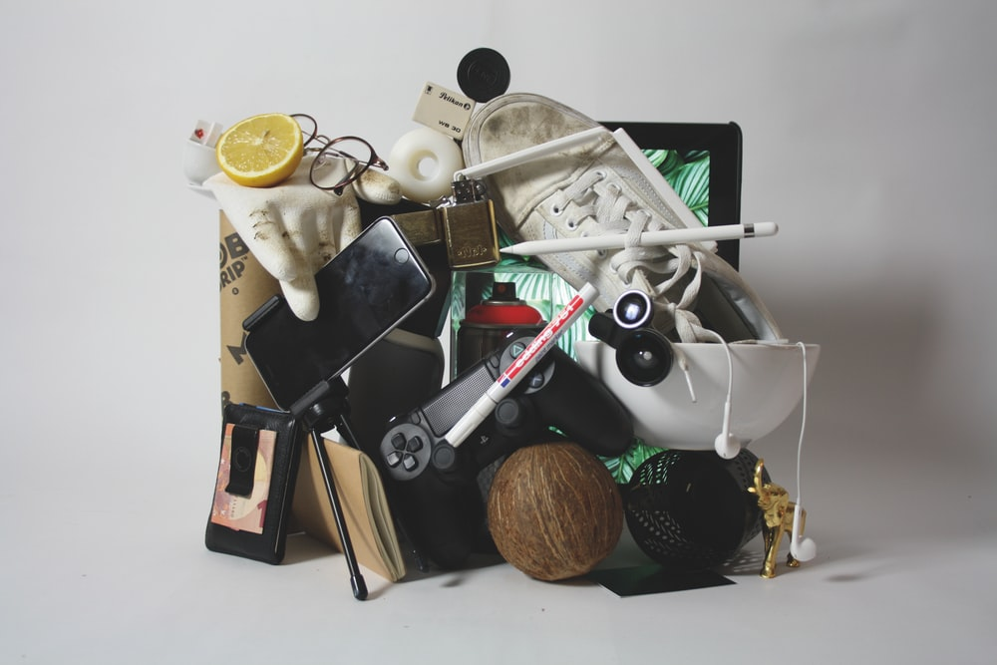
Education Infographic
Shopping list
In the news
When
Event
Unusual
Why
Second thoughts
Teachers
Education
Skills
Chris Bauman

